Slide 1
Predicting Future Stock Prices
Voo doo or Data?
Matthew Stidham

Slide 2
Data Description
Over 14 million data points from over 20 years of data and thousands of stocks

Slide 3
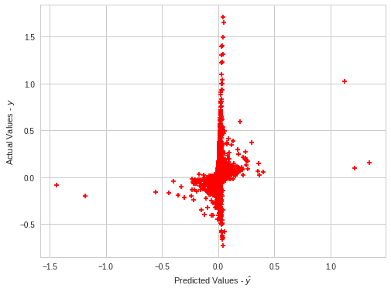
All Stocks Only Indicators
0.021 R squared

Slide 4
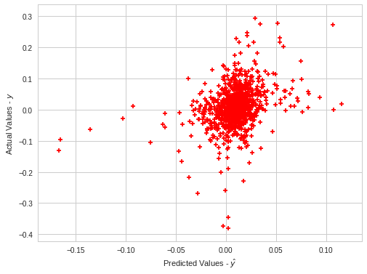
Google Trends Restaurant
R-squared = 0.116
open_2_d
Volatility
Dailyrate
Trends are insignificant
63% True direction

Slide 5
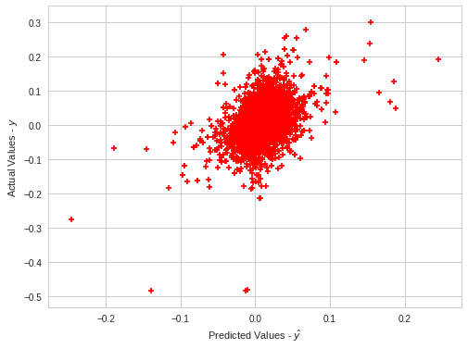
Google Trends Health Care With Indicators
0.176 R squared
-0.002 Cross-val Score
49% true positive or true negative rate

Slide 6
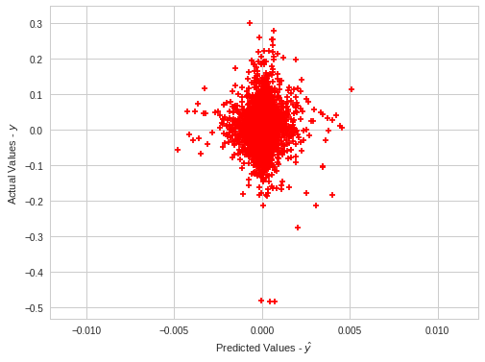
Google Trends Health Care No Indicators
0 R squared
33% true positive or true negative

Slide 7
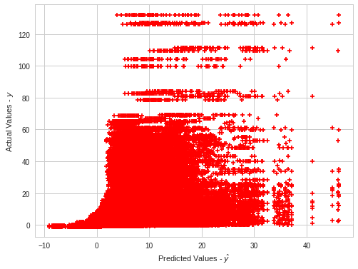
Large Finance Based on Momentum Kitchen soup
0.294 R squared
222 kurtosis
Open price 0.419
High 0.374
2 week gain 0.034

Slide 8
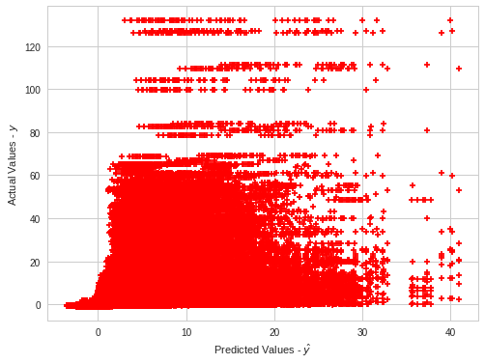
Large Finance Based on Momentum top 9 variables
0.275 R squared
226 kurtosis

Slide 9
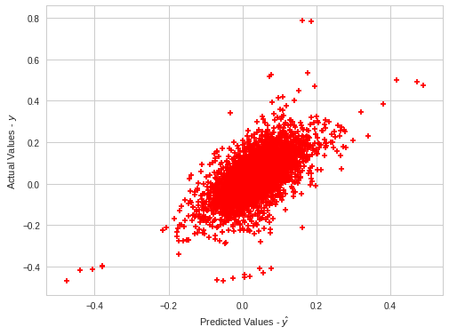
Health Based on Momentum Kitchen soup
0.411 R squared
8.219 kurtosis
4 week gain, 0.44

Slide 10
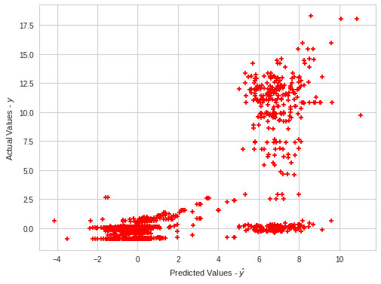
Restaurants Based on Momentum
0.55 R squared
4.761 Kurtosis
75% True Positive or True Negative
Adj_open
High price for day
Opening price

